Slide 1
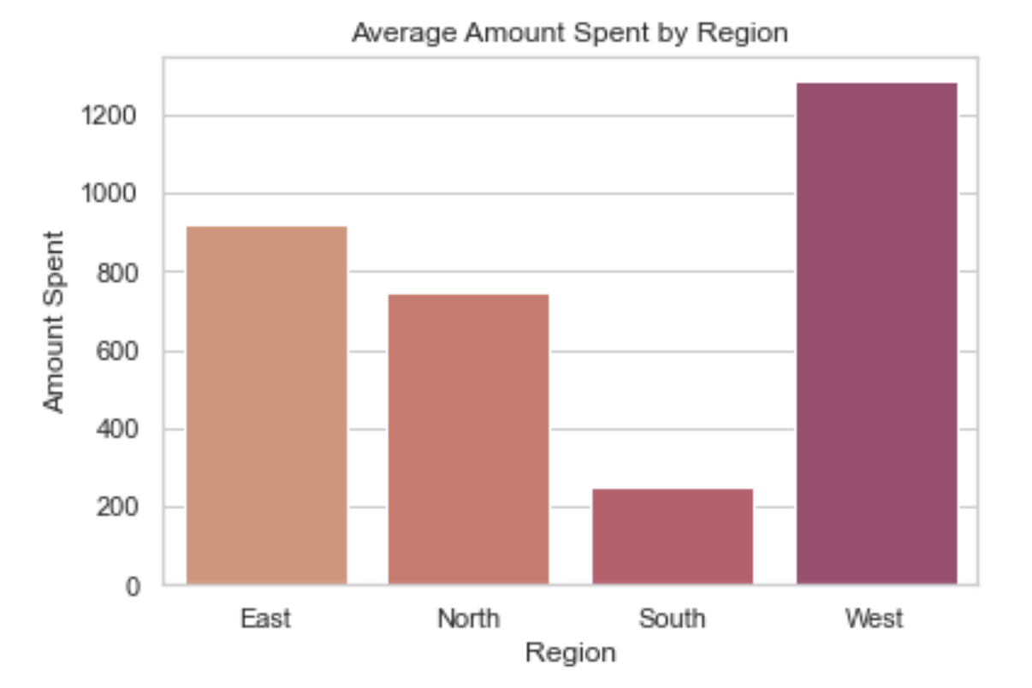
Blackwell Electronics
Prepared by: Holly Livingston
Data Analysis Report
Customer buying patterns vary depending on region for our products. Recent purchasing data has shown that the West region spends an average of $1,284 per transaction. Meanwhile, the South region sees a much smaller amount spent at $252 per transaction. I suggest we look into the reasons behind the lower transaction amounts for the South region.

Slide 2
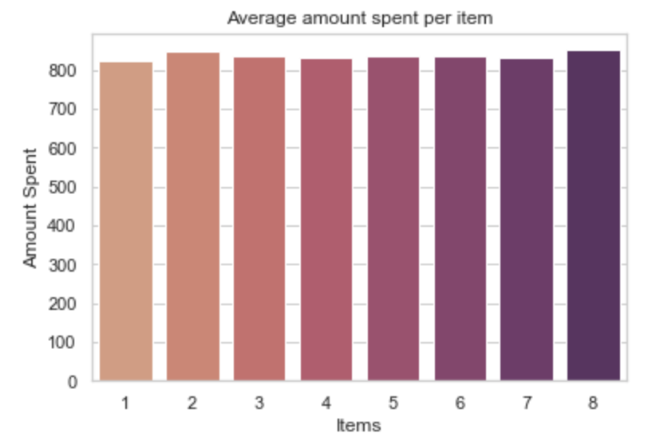
Blackwell Electronics
Prepared by: Holly Livingston
Average Spent Per Item
At this time, there is not a correlation between the amount spent and the number or items purchased.* Customers are still averaging around $800 whether or not they purchase 1 or even 8 items. In order to increase basket ring, we might want to focus on the reason that customers are only spending around this amount and what we can do to promote additional sales for higher ticket items.
*Current correlation is almost 0

